Slide 1

NIET
Greater Noida
Autonomous Institute
, •.ix z«
G e I future 9:a ady
Department of CSE (AIML)
Session (2023-24)
Mini Project (ACSE0659) Presentation on
“ResumeForge”
Submitted To:
Mr. Amar Pal Yadav Mr. Praveen Kumar
Group Member:
Nishant Kumar Nikhil Singh
Charit Sharma
(2201331520132)
(2201331520131)
(2201331520222)

Slide 2

ResumeForge – Where
AI Meets Professional Excellence
Empowering students and developers with AI-driven professional CV creation.

Slide 3
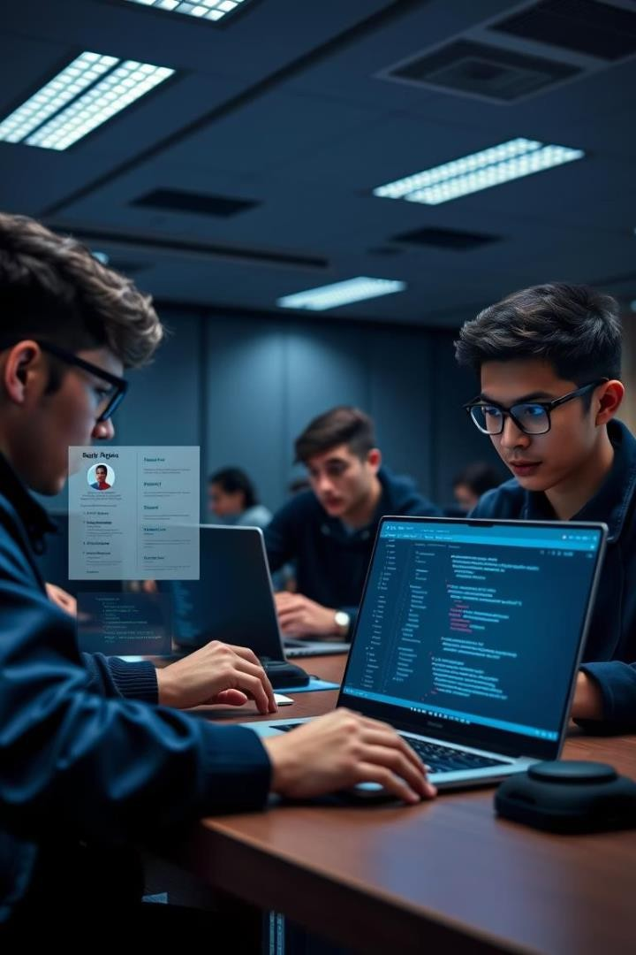
Overview
AI-Powered Builder
Tailored for Computer
Science students
LaTeX CV
Generation
Auto-generates professional CVs maintaining industry standards
Simplified Resume Creation
User-friendly input with structured formatting

Slide 4
Key Features
AI-Powered Resume Generation
Leverages Gemini API for structured LaTeX output
Live Resume Preview
Real-time LaTeX output visualization
Mobile-Responsive Design
Accessible on desktop and mobile devices
Autosave & Draft Mode (Planned)
Automatic data saving while editing
Modular Input System
Separate sections for Skills, Education, Projects
Sleek & Interactive UI
Animations built with Framer Motion
Multi-Theme Support (Planned)
Multiple LaTeX templates for customization
PDF Export & Download (Planned)
One-click final resume generation

Slide 5
Tech Stack
Frontend
Backend
AI Integration
Document Engine
HTML
Tailwind CSS
Framer Motion
Node.js
Express.js
Gemini API
Intelligent LaTeX generation
LaTeX
Professional formatting

Slide 6





Real-World Use Cases
Final-Year Students
Preparation for placement drives
Hackathon Teams
Quick, clean resume generation
Tech Workshops
Interactive resume-building tools
Freelancers
Consistent resumes for clients
Colleges
Integrated in career counseling portals

Slide 7
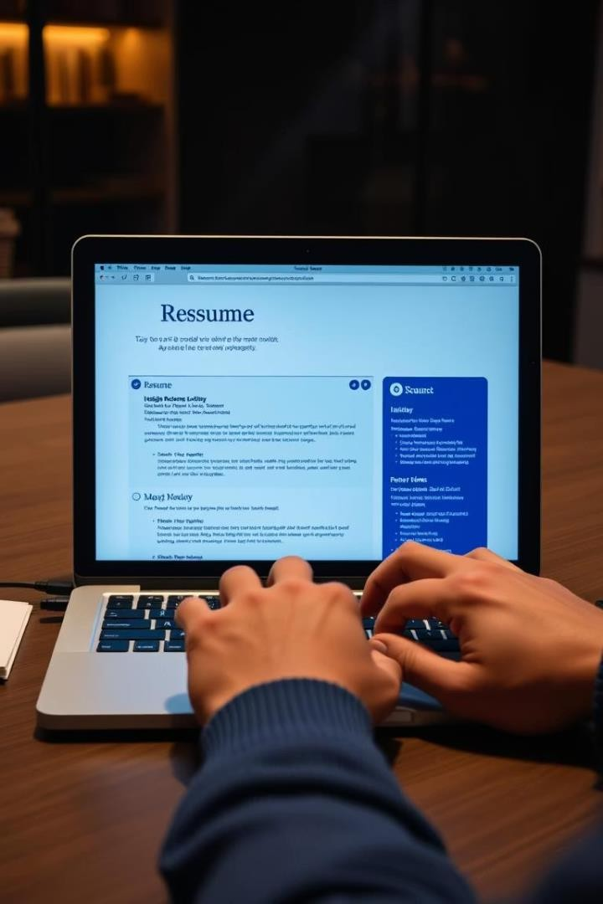

Usage Workflow
Fill Structured Forms
Summary, Experience, Skills, etc.
AI Generates LaTeX
Section-wise professional formatting
Preview & Export
Copy or download resume files

Slide 8
Contributing & Future Enhancements
Open Source Contribution
Upcoming Features
Contact
Email: nishantkr2003nna@gmail.com
Fork → feature branch → pull
request
Issues & suggestions welcomed
Template gallery with multiple styles
Direct PDF export
User accounts for resume saves
Enhanced AI prompt tuning

Slide 9



an

